Slide 1


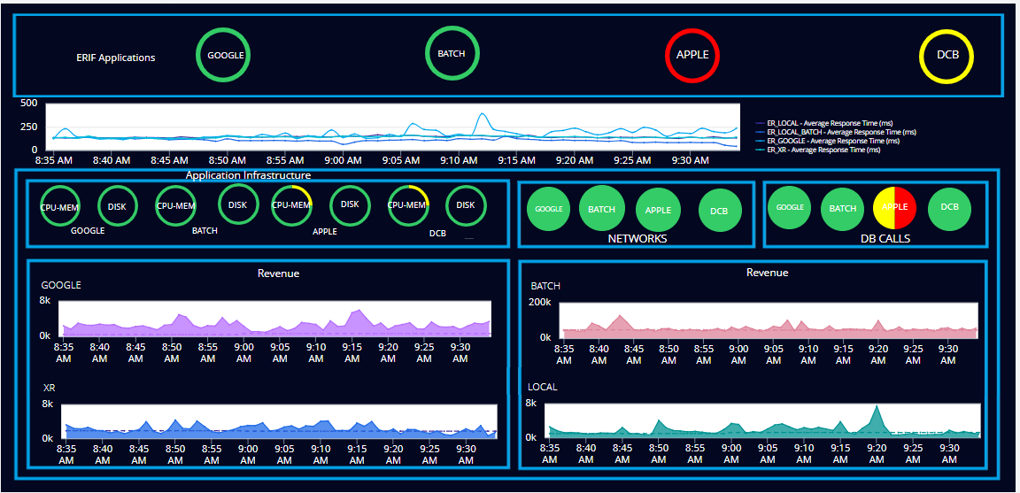
ER APPLICATIONS
ERIF APPLICATIONS Overall Performance
ER Applications overall performance graph displaying the average response time over a specified period
Indicators displaying memory usage and disk space consumption for each ER application.
Indicators showing applications network availability and database remote services health
Information points and analytics graph displaying the overall gross amount for each application, compared to a default baseline."

